Slide 1
Group-Esi
Zac de la butte aux Bergers – 12, rue du noyer à la malice – 95380 Louvres – France – www.group-esi.com
LOGISTICS FOR FAIRS,CONGRES,EXHIBITIONS,TRANSPORT OF WORKS AND ART and REMOVAL
We thank you in advance for your participation in our CSR approach as part of our ISO20121 certification
1 / 2
ORDER FORM
NAME OF THE SHOW: ____________________
Invoicing :
Company: _______________________
Contact: ______________________________
Phone: ____________________________
E-mail: _______________________________
Invoicing address: _______________________
________________________________________
TVA (EU): _________________________________
Exhibition company name:
_________________________
Hall & stand N°: ______________________
On site representative:__________________
Phone:__________________
Custom status: c Permanent import c Temporary Import c ATA carnet
In full accordance with our ISO20121 policy
We highly recommend the use of our advanced warehouse system
(Reception and consolidation of exhibitor’s goods in our logistics platform prior to delivery to the show)
No waiting time for your transporters, total compliance with the delivery deadlines to your stand, less vehicles around the exhibition sites, Co2 reduction.
Transport
Entree Show
c Unloading in advanced warehouse
c Transport by us
c Transport by ESI
Air c Sea c Road
Delivery time and hour on stand:________
Exit Show
c Collection on stand and transfer to warehouse
c Transport by us
c Transport by ESI
Air c Sea c Road
Collection date and time from stand: _______
Detail Shipment
Nb pieces: ____________ Total weight: _________ Total volume: __________
Détail or size of shipment: ______________________________________
_________________________________________________________________
Destination after the show: _____________________________________________________________________________

Slide 2
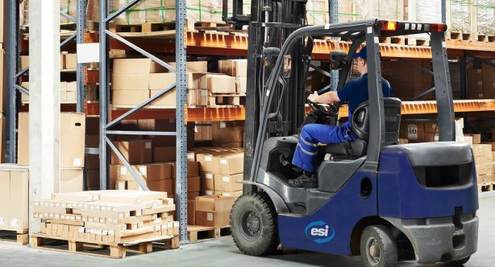
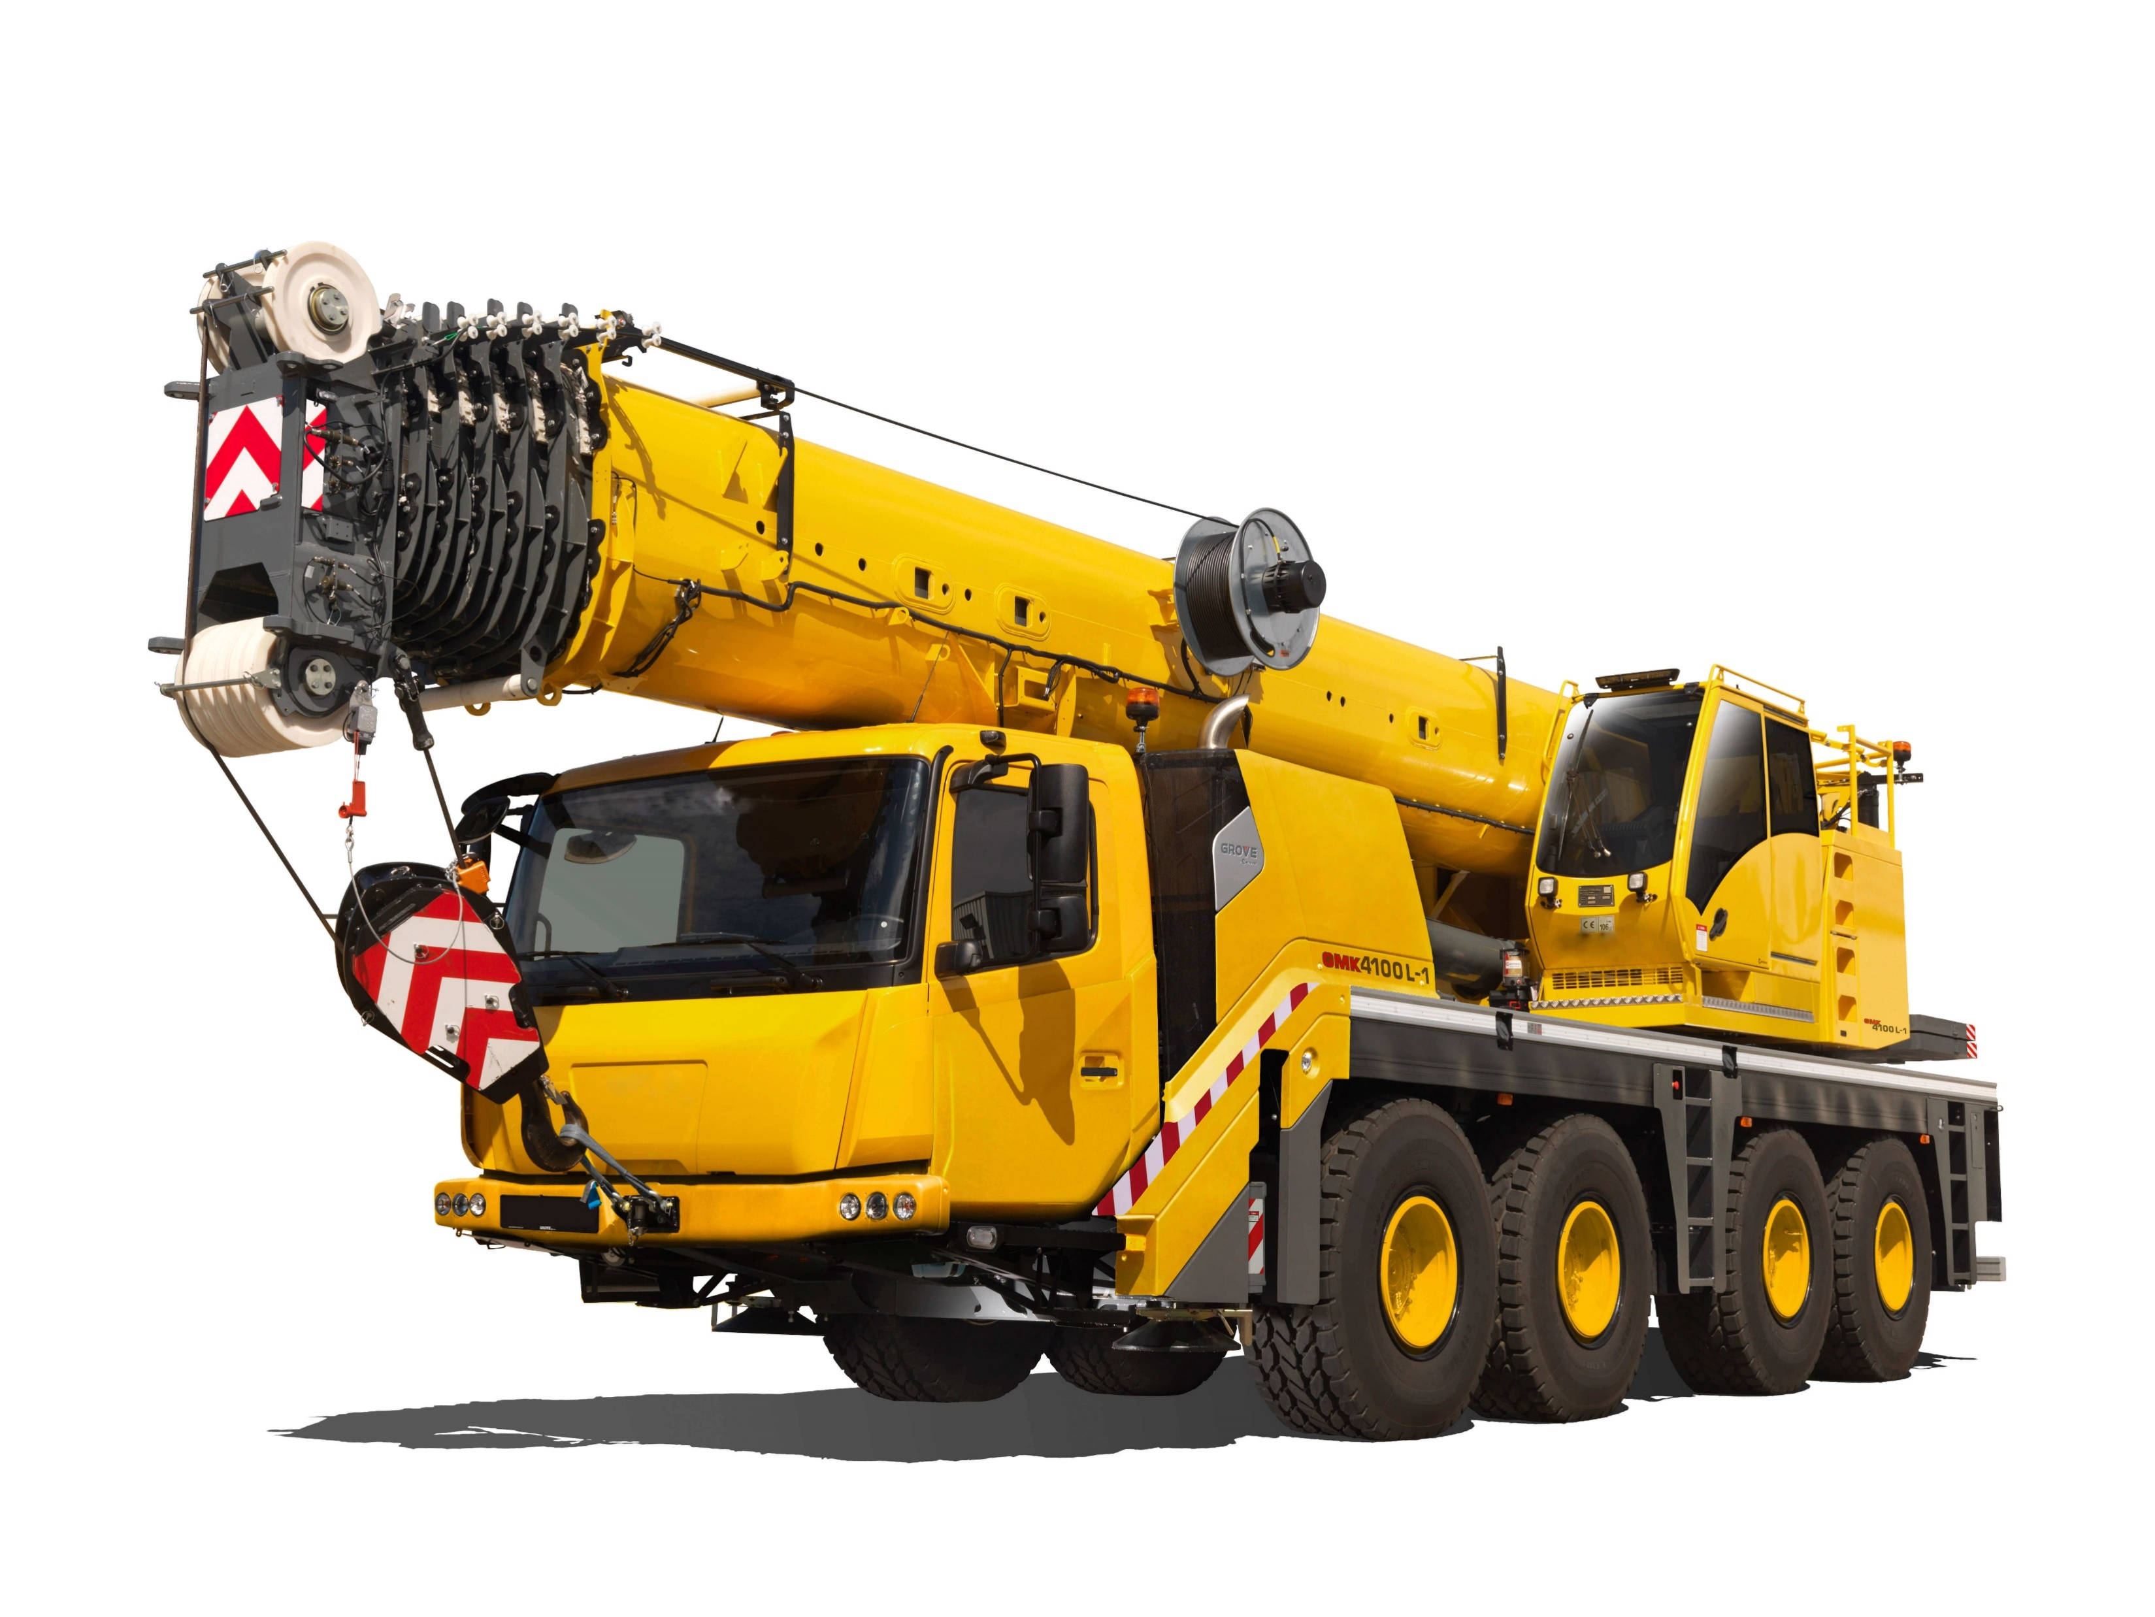
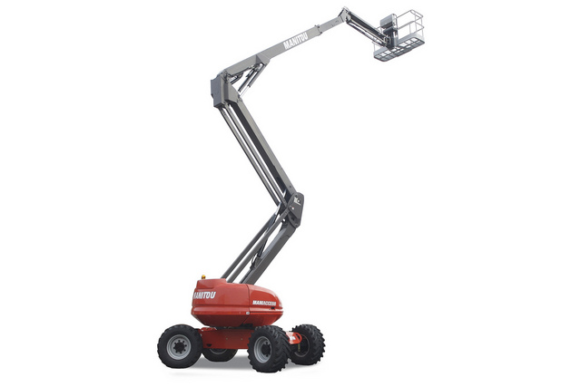
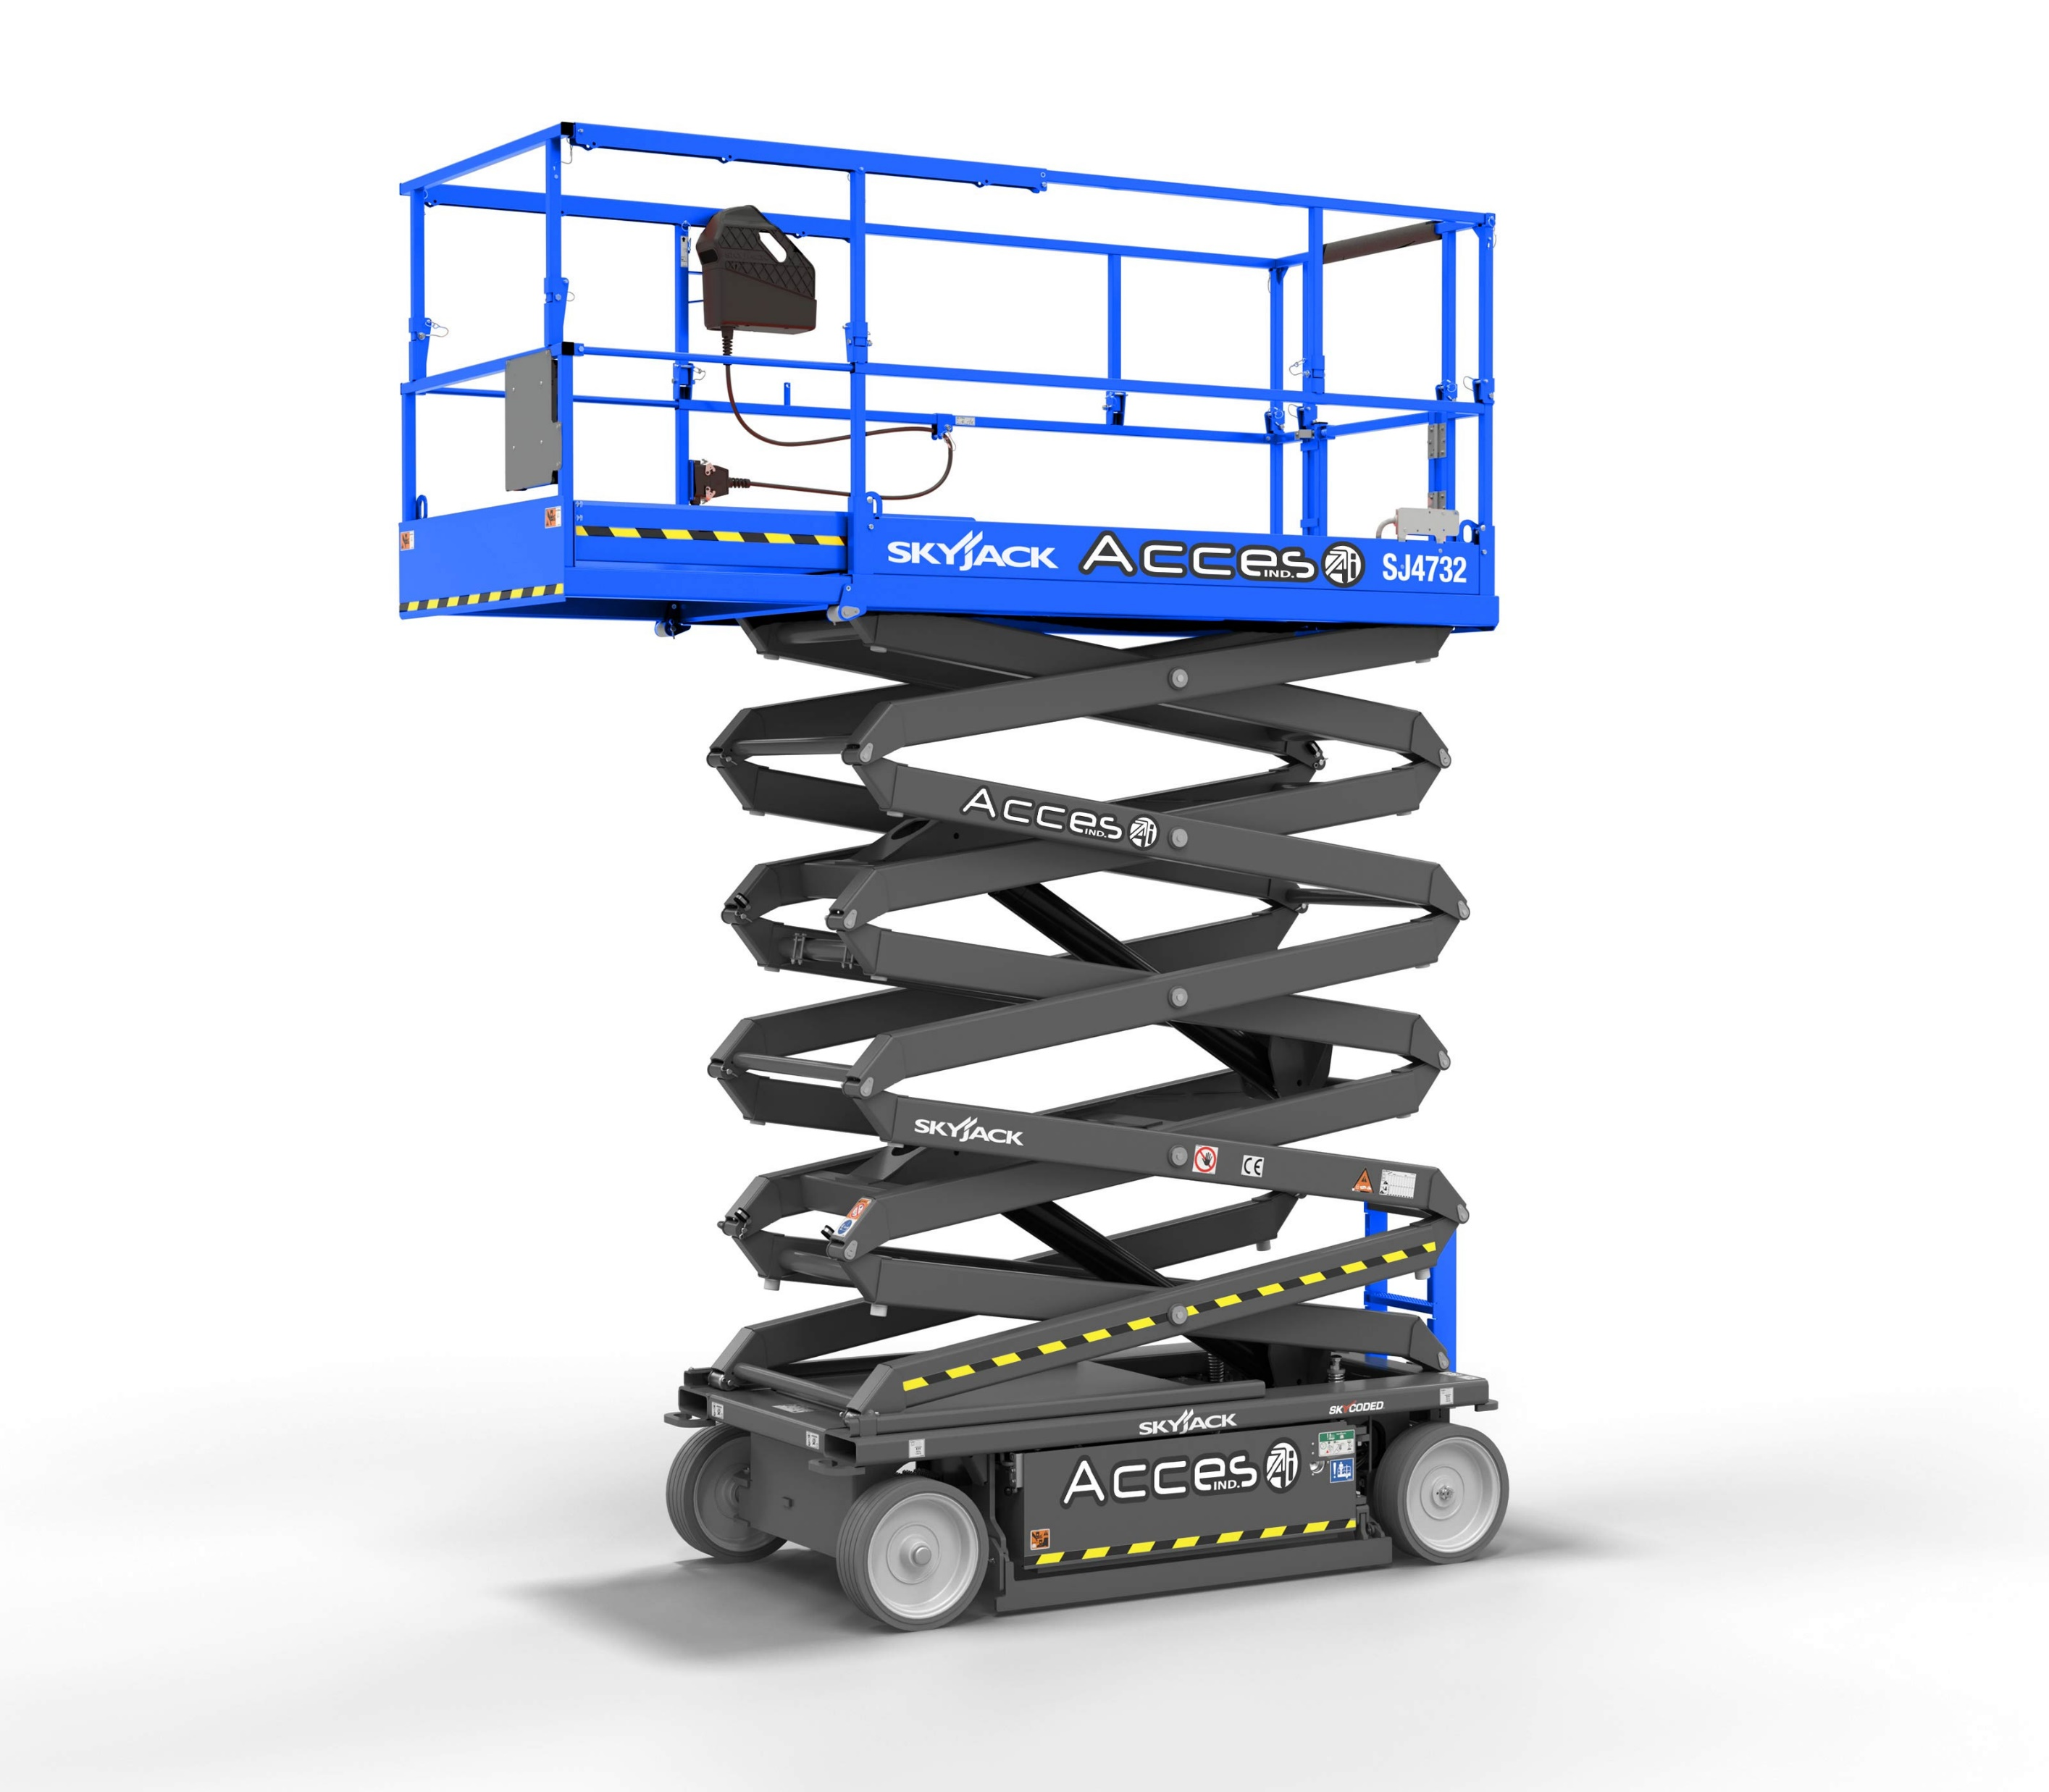
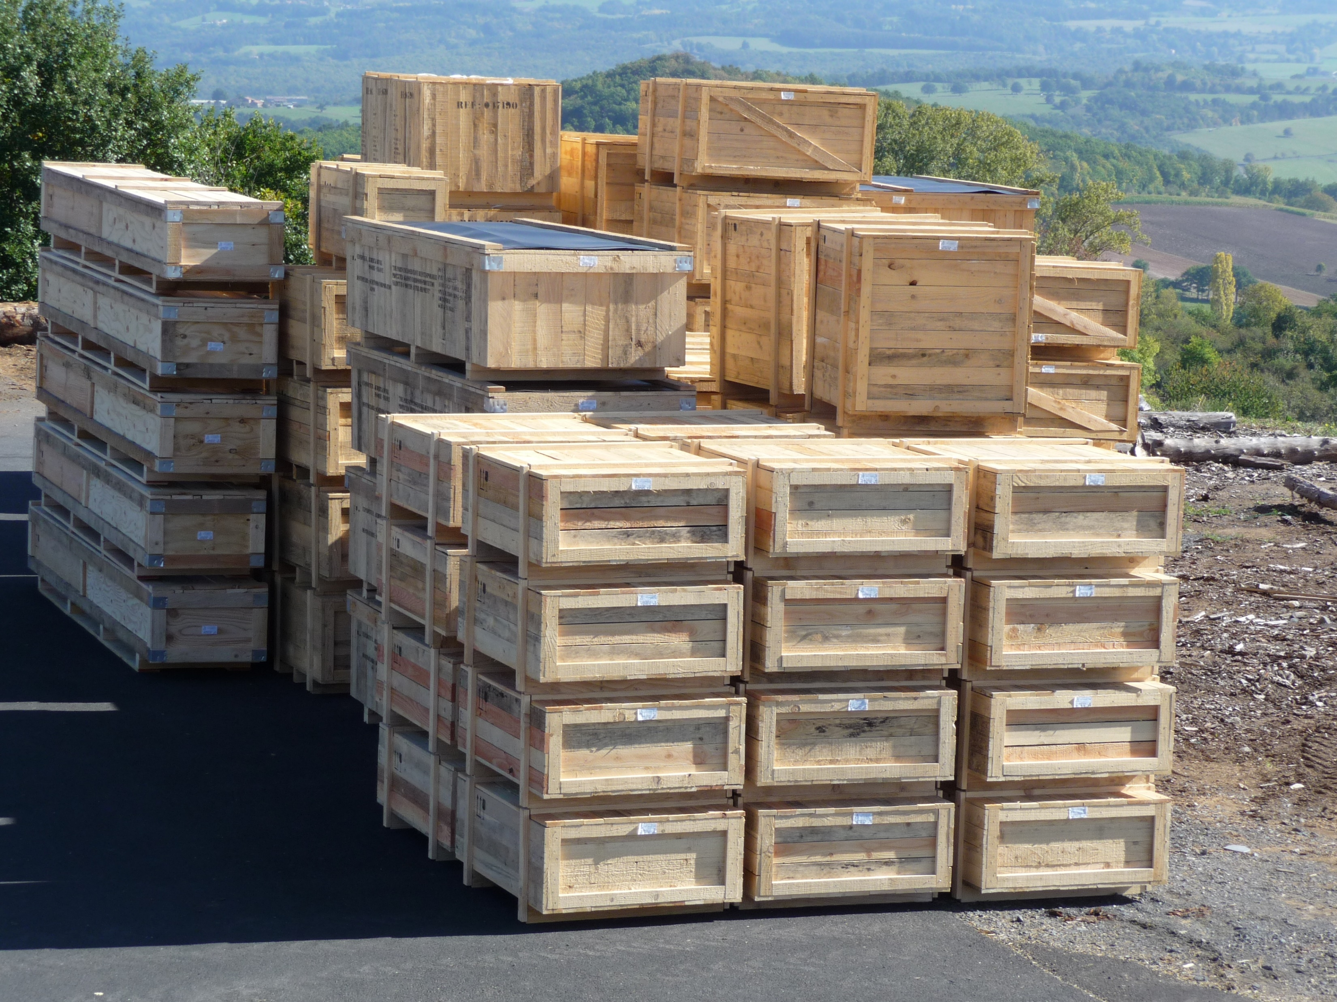
ORDER FORM
2 / 2
ON SITE HANDLING
Forklift with operator
Unloading, loading, handling on stand…
Mobile crane with opérateur
c Forklift up to 3T
c Forklift up to 5T
c Forklift 8T
c Forklift 16 T
c Crane 30 T
c Crane 50 T
c Crane 80T and over
c Slingman
Telescopic lift
Scisor lift
c With opérateur
c Working high12-14 m
c Working high 18-20 m
c With opérateur
c Working high 8-10 m
c Working High 12-14 m
For rentals of driverless platforms: a driver's license and authorization from the employer is required
c Workman
c Empty storage
Full storage, tools, ladders….
Daily deliveries during the show
Date and place: ___________________________________________
Sign: Stamp:
In order to guarantee you the best service, sending your order no later than 3 weeks before the operation is strongly recommended.

